Slide 1
By Irina Yeager, Kiran Devanath, Leslie Vazquez
ETL Happiness Report: A Project Comparing
Income to Happiness

Slide 2
Background
Happiness is one of the most abstract terms in the world. What makes you happy? Is it money, love, family, or perhaps your career? The purpose of this project is to use open data sources to answer the following research questions:
Which region has the happiest countries?
Does the level of income show greater impact on happiness score?
Does the trust in government show greater impact on happiness score?

Slide 3
Extracting Data
Two CSV files were extrapolated from Kaggle Website:
2019.csv
World Happiness Score for 156 countries for the year 2019 based on several factors such as gross domestic product (GDP) per capita, social support, perceptions of corruption, and freedom to make choices.
WB_Income_Group.csv
World Income Groups for 256 countries/regions
Links:
https://www.kaggle.com/sowmya96/data-analysis-on-world-happiness-report
https://www.kaggle.com/fkosmowski/country-income-and-inequalities?select=WB_Income_Group.csv

Slide 4
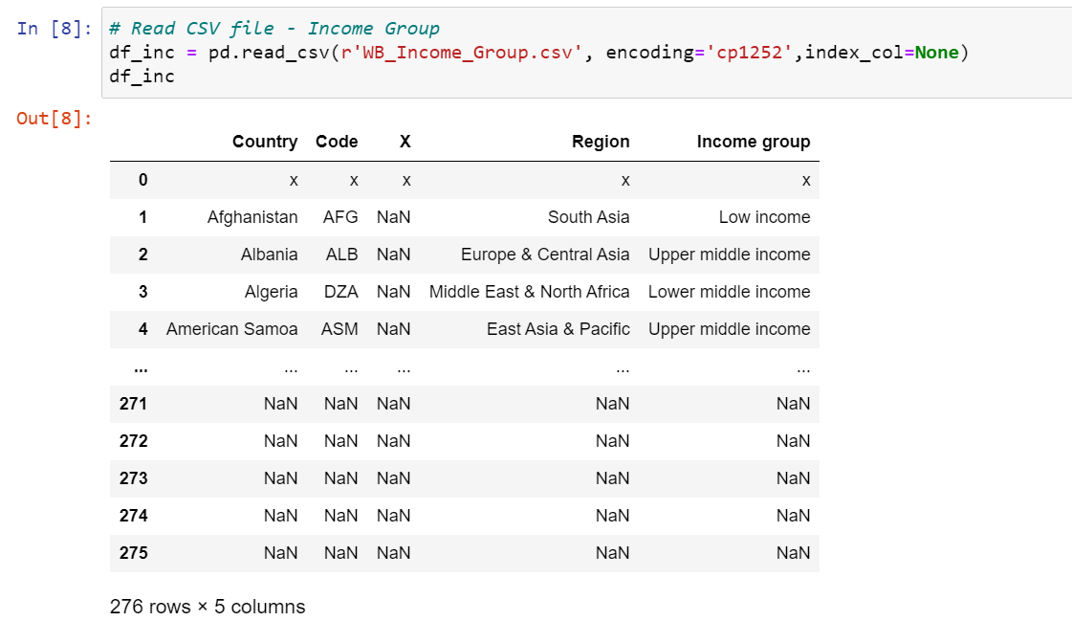
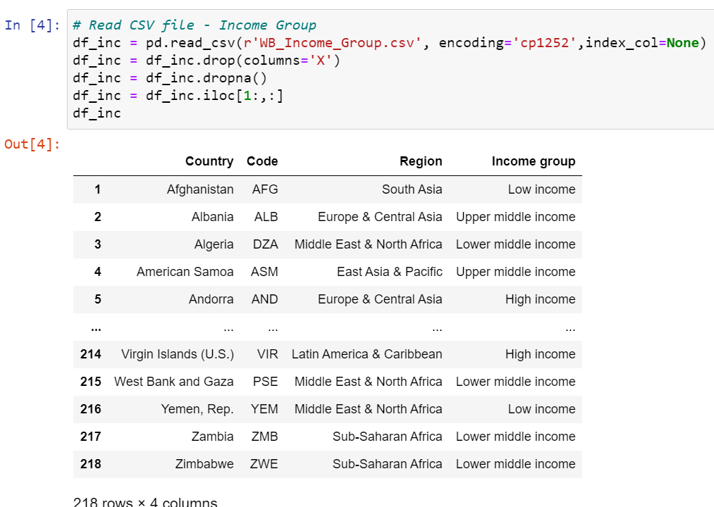
Transforming Data

Slide 5
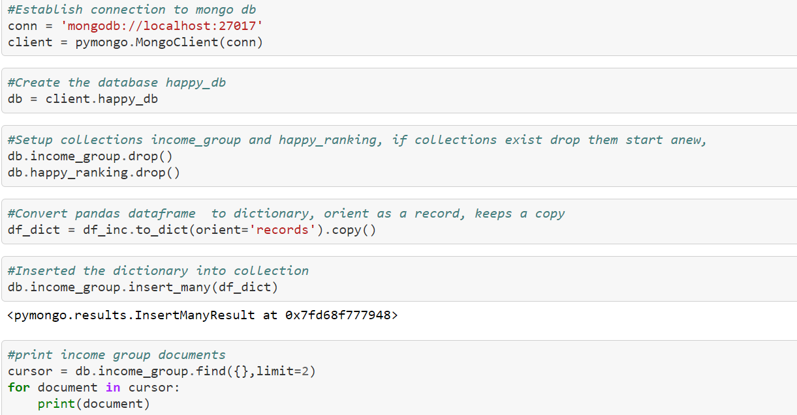
Loading Data: pymongo

Slide 6
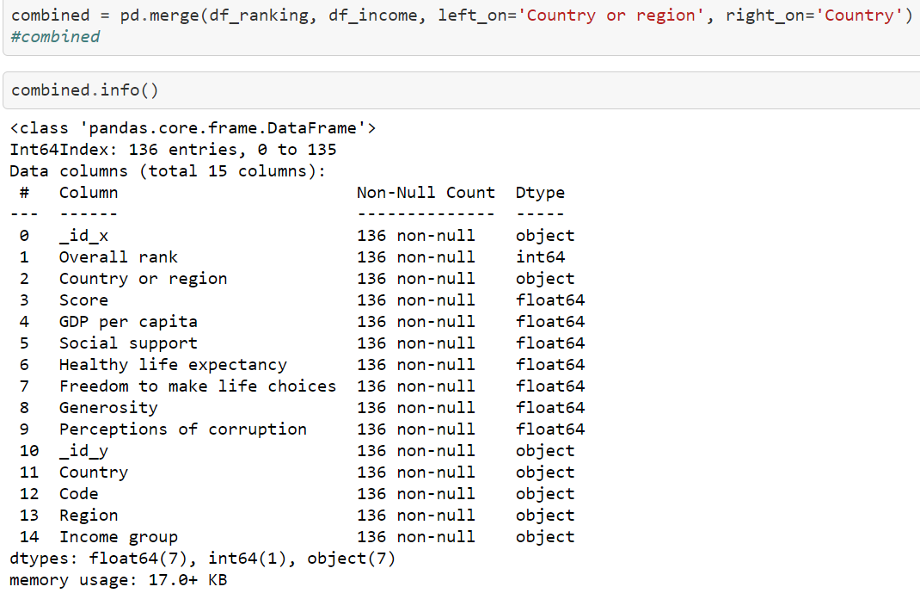
Loading Data: pymongo

Slide 7
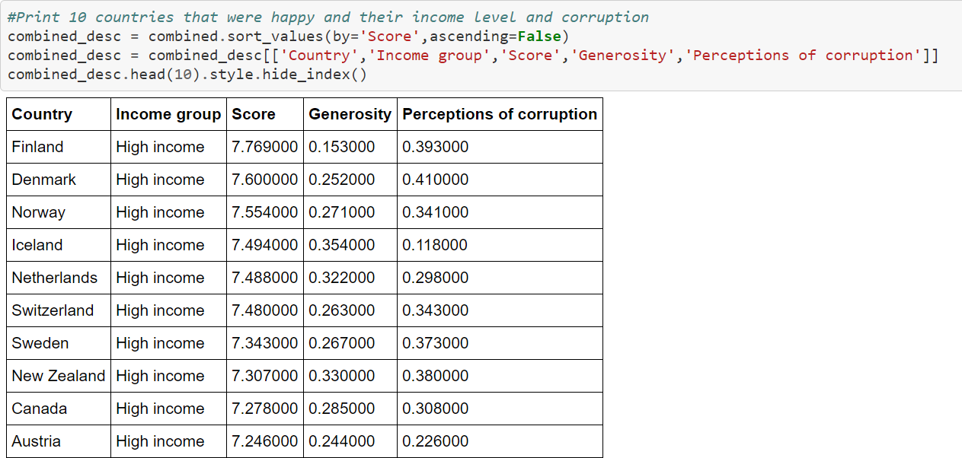
Top 10 Happiest Countries

Slide 8
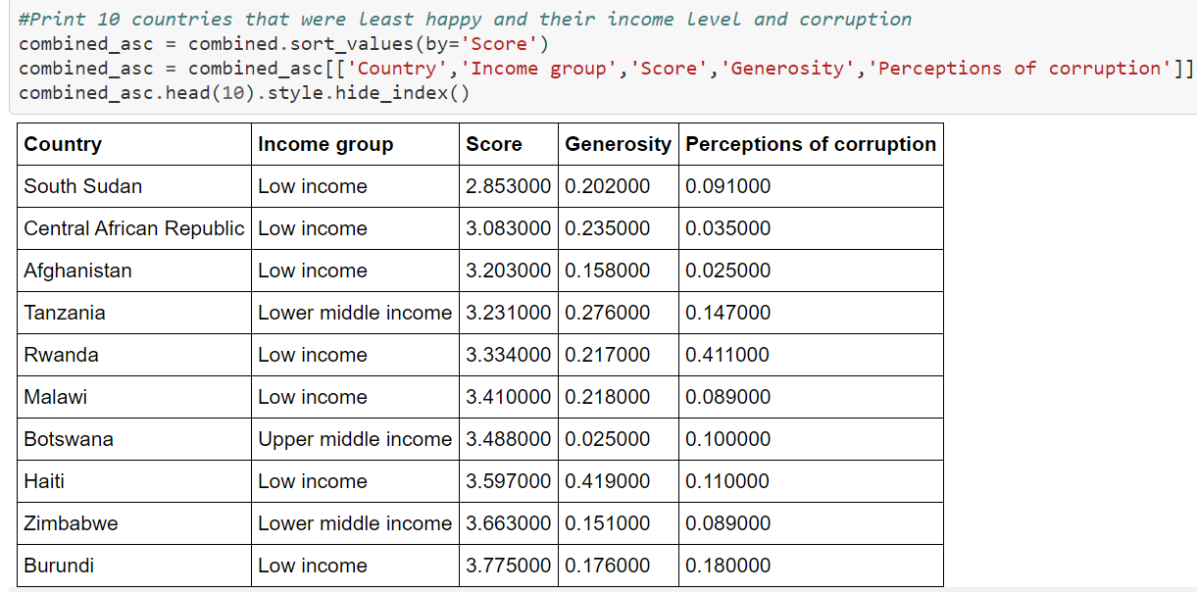
10 Least Happy Countries

Slide 9
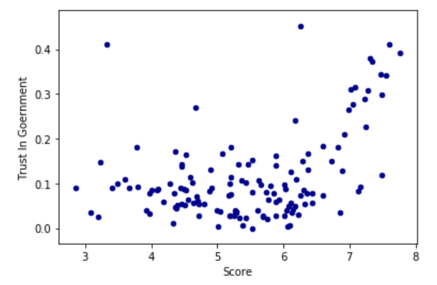
Trust in Government vs Happiness Score

Slide 10
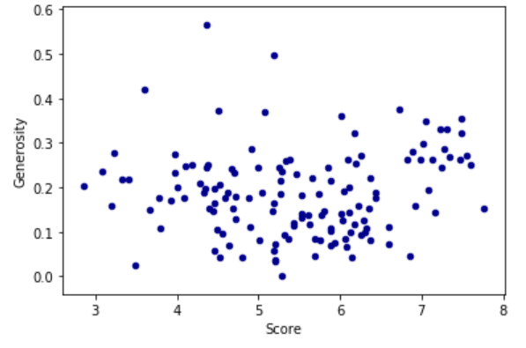
Generosity vs Happiness Score

Slide 11
THE END

